Slide 1

Analyse customer review data to uncover findings for British Airways
FOR PURPOSE OF FORAGE WORK EXPERIENCE
Reporter: Shuvojit Das
Date: 26.05.2023

Slide 2
CONTENT
01
Customer Recommendation
02
Passengers Seat Type
03
Type of Traveller
04
Customer Recommendation according to Seat Type
05
Total number of recommendation for each Seat Type

Slide 3
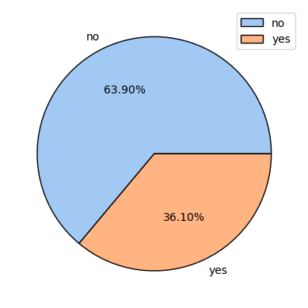
Customer Recommendation
01
Here we have 1000 customer review. Out of 1000, 63.90 % are not recommending British Airways.

Slide 4
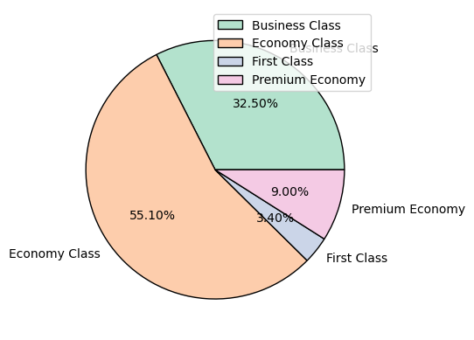
Passengers Seat Type
02
From this graphical representation we can say that our main target audience is Economy Class Passengers.

Slide 5
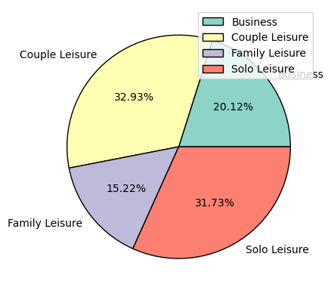
Type of Traveller
03
From this analysis we can say that couple and solo leisure was our main target audience.

Slide 6
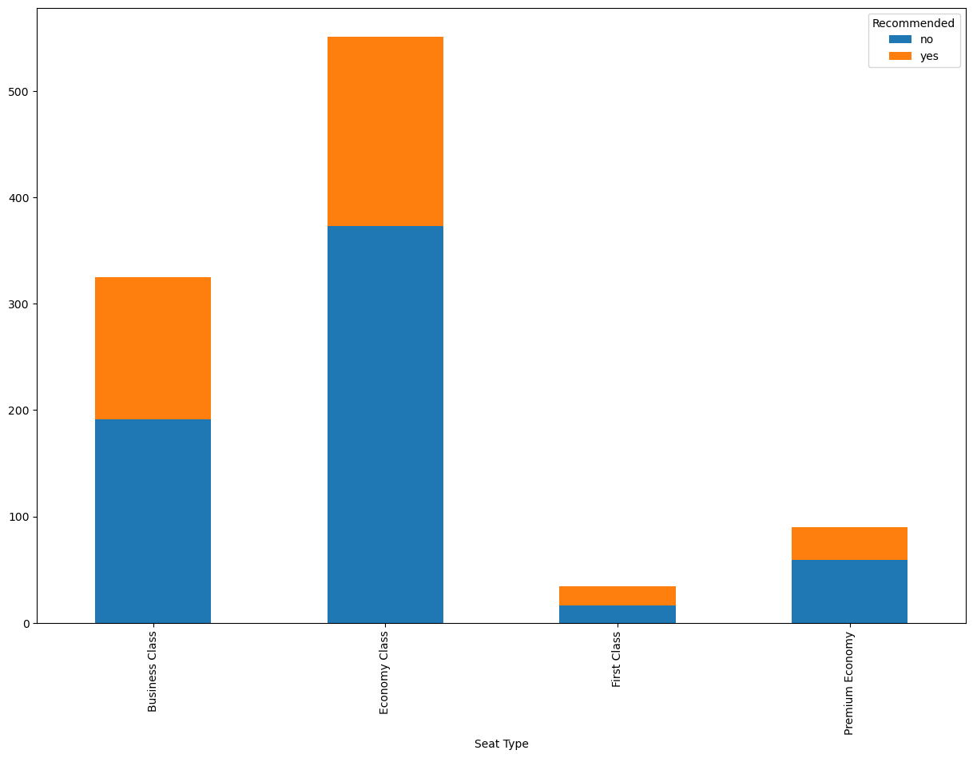
Customer Recommendation according to Seat Type
04
In all four class the count of negative recommendation is more.

Slide 7
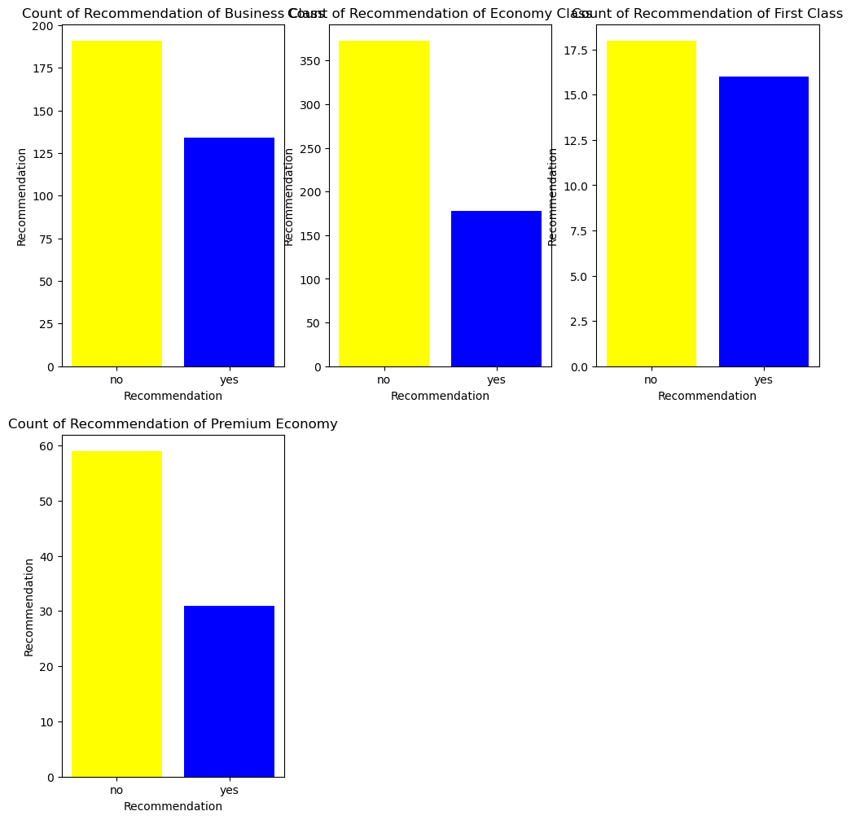
Total number of recommendation for each Seat Type
05
Economy Class - 551
Business Class - 325
Premium Economy - 90
First Class - 34

Slide 8
THANK YOU!
THANK YOU FOR WATCHING

